Slide 1
Sales Effectiveness: Use, Benefits, and Pitfalls (Part 1)
National Association of Motor Vehicle Boards and Commissions 2016 Fall Workshop
Russell P. McRory Arent Fox LLP New York, NY | James C. McGrath Seyfarth Shaw LLP Boston, MA

Slide 2
Disclaimers!
Expressing personal views
Not speaking on behalf of any client or company
All information has been publicly disclosed

Slide 3
History and Evolution
How to measure dealer sales performance?
Originally a quota/objective based system using projections/estimates
Sales effectiveness developed in the 1970s using actual historical data
Segmentation evolved in 1980s – measuring performance against competitive vehicle type
National, Regional, State benchmarks

Slide 4
What is Sales Effectiveness?
Sales Effectiveness is a fraction:
Numerator is a dealer’s actual sales (typically annual).
Denominator is the dealer’s “expected” sales.
Expected sales are for each segment:
The universe of vehicles is divided into “segments,” i.e. small sedan, pick-up trucks
The brand’s market share in the benchmark territory (state or region) in each individual segment where it competes is calculated.
Those state/regional segment market shares are applied to the segment registrations in the dealer’s local assigned market territory.
The results of each segment are added to give the dealer’s “expected sales”.
Sales Effectiveness = $\frac{\text{Dealer}\text{′}\text{s} \text{Total} \text{Sales}}{\begin{aligned}\text{Expected} \text{Sales} \text{Based} \text{on} \\ \text{Benchmark} \text{Average}\end{aligned}} \text{x}\text{ 100}$
Brand’s Statewide Segment
Expected Sales = Market Share in x Registrations in
Segment Dealer’s Market
(repeated for each vehicle segment in which Brand competes)

Slide 5
Expected Sales for Mid-Sedan Segment
Chevrolet’s entrant in the mid-sedan segment is the Malibu. Other members of the segment include the Honda Accord, Toyota Camry, etc.
Assume the Malibu’s market share is 10% statewide.
Assume there are 1000 mid-sedan’s registered in a particular dealer’s market territory.
That dealer would be expected to sell 100 Malibus.
That calculation is repeated for each segment and all the segment totals are totaled to get the “expected sales” figure.

Slide 6
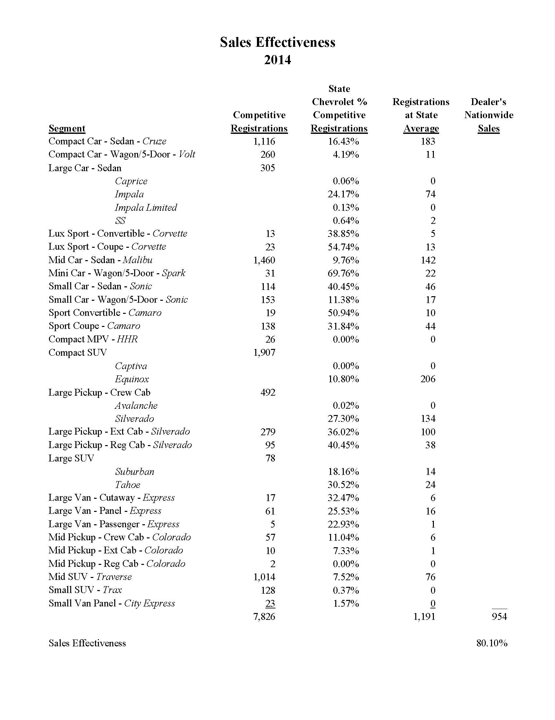
6

Slide 7
How is Sales Effectiveness Used?
Measure Performance vs. Market Potential
Identify Lost Opportunity and Likely Causes
Support Business Counseling
Drive Market Actions
Construct Sales Objectives
Award Incentives
Facility Guides

Slide 8
Perceived Benefits
Powerful tool - actual consumer purchasing data
Avoids projections, extrapolations, or estimates
Segmentation provides significant adjustment
Great equalizer – allows comparison of different sized dealerships/markets
Adjusts for economic conditions, market opportunity and strength of brand within comparison area
Business tool for dealers and manufacturers
Objective, predictable, transparent, administratively convenient
“Art and science” approach - termination rare

Slide 9
Perceived Shortcomings
Common complaint among dealers is that they do not understand how sales effectiveness is calculated or used.
Segmentation alone is not a sufficient adjustment. Consumer preferences are much more complex than popularity of broad segments (pick-up trucks vs. sedans).
Does not account for level of competition, import or domestic biases, factory lease/finance programs, factory advertising, etc.
As used by manufacturers, meeting or exceeding “average” is a contractual requirement, meaning that at any one time, half of all dealers are deemed out of compliance with their dealer agreements.
Not just about termination. The expected sales number (the denominator of the sales effectiveness formula) is also used to justify adding new dealers to a market, setting facility requirements, setting sales objectives tied to monetary incentives, allocation of new vehicle inventory, etc.

Slide 10
Legal Challenges
Typical context - termination, add point, relocation, facility requirements, buy-sell, incentive program, sales objectives, etc.
Fact specific
Primarily involved whether the benchmark area was sufficiently similar to the study area
Does segmentation provide enough of an adjustment?
Sales effectiveness upheld and rejected depending on the specific circumstances

Slide 11
Beck Chevrolet v. GM

Slide 12
Background - A Long and Winding Road
Federal action and state DMV proceeding.
Federal action was a “preemptive” strike under NY statute to challenge GM’s sales performance standard before a termination was attempted. Letters from GM stated that unless sales effectiveness requirements were met, franchise would not be renewed.
During the federal action, GM issued a termination notice to Beck. Beck commenced the statutory challenge in the NY DMV rather than federal court.
What does the statute say?
“[i]t shall be unlawful for any franchisor, notwithstanding the terms of any franchise contract: ...
“[t]o use an unreasonable, arbitrary or unfair sales or other performance standard in determining a franchised motor vehicle dealer’s compliance with a franchise agreement.”

Slide 13
Strengths of Beck’s position
Beck performed well in other important metrics: CSI, training, working capital, advertising, pricing, pricing to consumers.
Over 80% of downstate NY dealers were also “failing” under RSI, including many below Beck. Easy sell that downstate metro NY consumer preferences very different than more rural upstate.
Made it easy to argue that Beck was not a bad dealer, but rather, that the Chevrolet brand had a larger problem in the NY metro market.
Large disparity of Chevrolet brand performance upstate vs. downstate.
Upstate Chevrolet had triple the market share than it did downstate.
Almost three-quarters of Chevrolet’s were sold upstate, but only half of all cars and light trucks were sold upstate.
Over 80% of Chevrolet dealers were located in upstate counties.
In short, the NY State benchmark was dominated by upstate Chevrolet dealers facing consumer preferences and market conditions very different than those faced by downstate Chevrolet dealers.

Slide 16
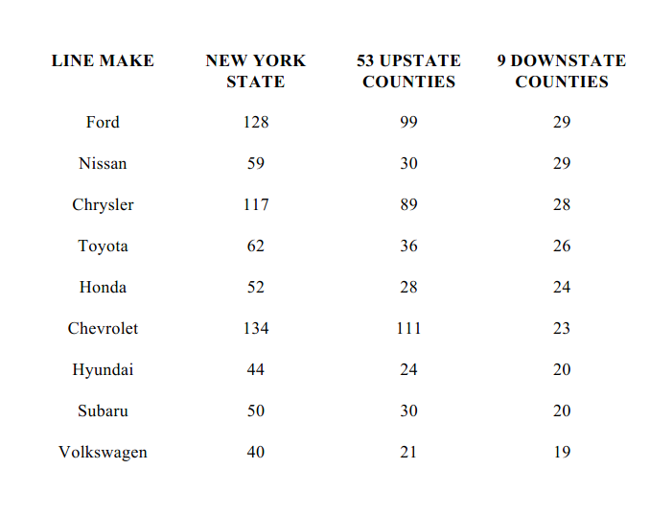

Slide 17
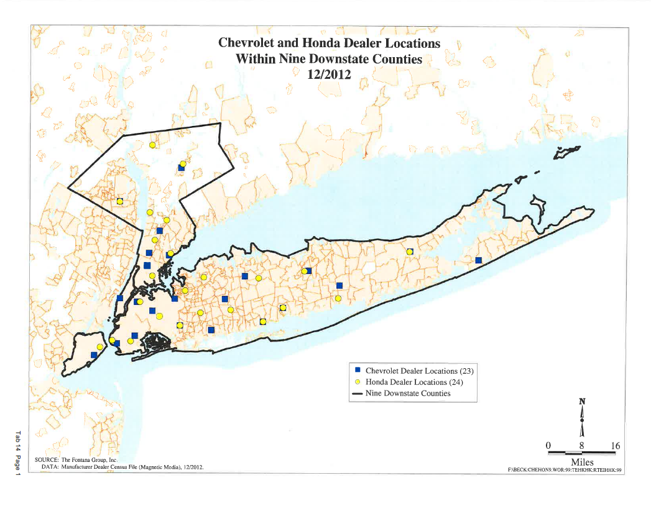

Slide 18
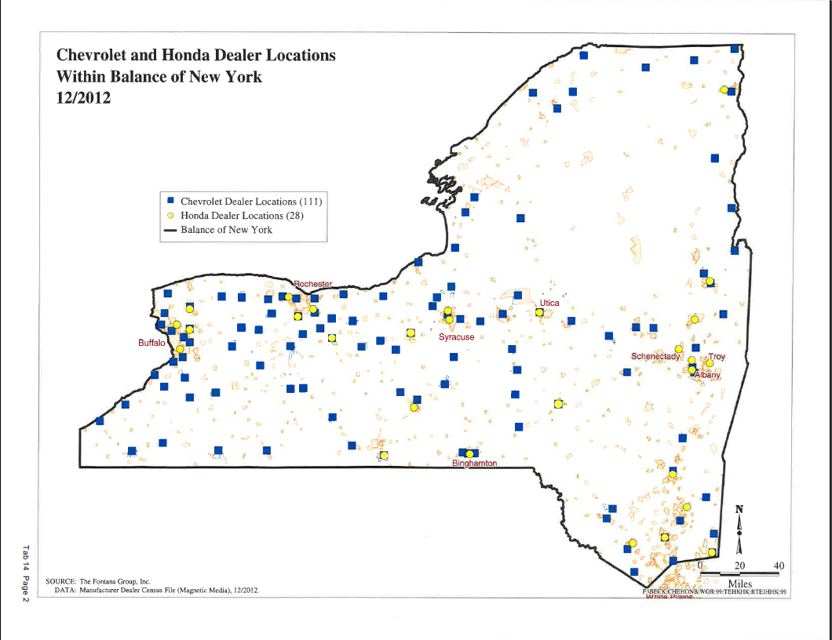

Slide 19
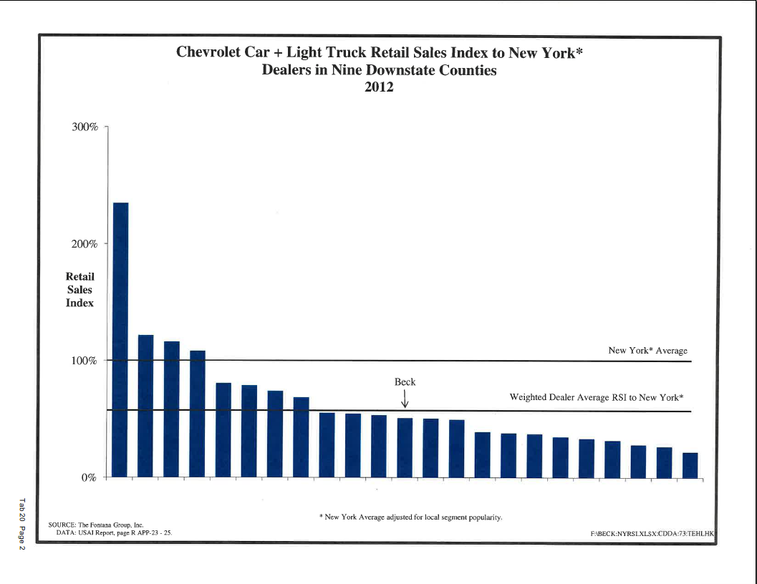

Slide 20
Strengths of GM’s position
GM had made significant structural changes to and investment in NY metro market
Beck signed a participation agreement promising improvement over 3 year period: 70, 85, 100
Benefitted from a significant (25%) segment adjustment
Operational issues despite assistance - allocation, counseling, business plan, facility, advertising, sales manager
Beck showed no improvement in its RSI
In addition to RSI, GM considered “other relevant factors”
Chevrolet Bias?
Several other “downstate” NY Chevrolet dealers were effective or had shown material improvement
Beck outsold by neighboring Chevrolet dealer in its own market
Import Bias?
Ford and Chrysler doing great in Yonkers (on same street as Beck)

Slide 26
Procedural History
Federal District Court rules in favor of GM after trial
DMV ALJ then grants summary disposition in favor of GM upholding termination
DMV Appeals Board reverses and ALJ finds in favor of Beck
Second Circuit certified following question to NY Court of Appeals:
Is a performance standard that requires “average” performance based on statewide sales data in order for an automobile dealer to retain its dealership “unreasonable, arbitrary, or unfair” under New York Vehicle & Traffic Law section 463(2)(gg) because it does not account for local variations beyond adjusting for the local popularity of general vehicle types?
NY Court of Appeals reformulates as follows:
Is a performance standard that uses "average" performance based on statewide sales data in order to determine an automobile dealer's compliance with a franchise agreement "unreasonable, arbitrary, or unfair" under New York Vehicle & Traffic Law section 463(2)(gg) because it does not account for local variations beyond adjusting for the local popularity of general vehicle types?
Decision rendered May 3, 2016 - Second Circuit proceeding pending

Slide 27
Beck NY Court of Appeals Decision
“GM measures a dealer’s sales performance by comparison to a statewide class of dealers, but adjusts the standard to reflect certain local market peculiarities with respect to one metric: local consumer purchasing preferences for certain vehicle types”
“Yet, customer purchases are influenced not solely by preferences for a type of vehicle, for which GM accounts through its segmentation formula, but also by brand popularity and import bias.”
“GM’s exclusion of local brand popularity or import bias rendered the standard unreasonable and unfair because these preference factors constitute market challenges that impact a dealer’s sales performance differently across the state.”
“It is unlawful under section 463(2)(gg) to measure a dealer’s sales performance by a standard that fails to consider the desirability of the Chevrolet brand itself as a measure of a dealer’s effort and sales ability.”
“GM essentially argues that it can set a standard that misrepresents external market forces. However, measuring the dealer’s performance against a market the dealer never faces is not reasonable or fair within the meaning of section 463(2)(gg).”
“The standard used by GM excludes local variance in market competitiveness, and masks the dealer mediocrity of which GM complains. To comply with the Dealer Act, if a franchisor intends to measure a dealer’s performance based on a comparison to statewide data for other dealers, then the comparison data must take into account the market-based challenges that affect dealer success.”
“…this is an industry in which the parties hold unequal bargaining positions, and an industry standard may reflect the entrenchment of the very inequality and favoritism that the legislature sought to counterbalance in the Dealer Act. Thus, GM may not rely on a standard that is unreasonable and unfair simply because of its prevalence within an industry the legislature sought to regulate.”

Slide 28
Beck Dissent
Fact Question: “The[] general and amorphous adjectives ‘unreasonable,’ ‘arbitrary’ and ‘unfair’ are similar to those found in the Uniform Commercial Code and lend themselves to varying interpretations depending on the circumstances of a particular business situation.”
Factfinder Upheld Standard: “District Court conducted a bench trial over several days and rendered a determination that the RSI performance standard, which uses a statewide sales average adjusted for local conditions, was not unreasonable, arbitrary or unfair. In making that determination, District Court considered and rejected the testimony of Beck's expert that the standard did not account for brand popularity and import bias, holding that the Retail Sales Index's (RSI) use of ‘segmentation’ adequately accounted for those particular variables. Crediting the testimony of GM’s two experts, District Court also determined that the RSI standard was ‘administratively convenient,’ ‘objective,’ and ‘uniformly applied.'”
Majority Avoided Facts: “Putting aside that what constitutes an “unreasonable,” “arbitrary” or “unfair” standard is a factual determination, I do not believe it is this Court’s role or function to determine, as a matter of law, that GM’s failure to include these particular “preference factors” [local brand popularity or import bias] as part of its currently-formulated RSI violated section 463(2)(gg).”
Art and Science Approach: “It is evident from the record that the RSI is a tool utilized by GM to determine if a franchisee is achieving certain benchmarks, and, if not, the RSI operates as a canary in the coal mine to alert GM that the franchisee needs assistance.”

Slide 29
Beck’s Significance – Dealer View
Segmentation as the sole adjustment to large geography benchmarks probably over. Will have to add other adjustments and/or use more localized benchmark territory.
Will make terminations, add points, relocations based on existing dealer(s) sales effectiveness (or market registration effectiveness) more difficult
Big side effect on facility requirements based on “expected sales” and incentive programs that pay money based on meeting sales objectives tied to this metric.

Slide 30
Beck’s Significance - Manufacturer View
Court went too far - ignored the District Court’s corroborative findings on reasonableness of RSI.
Good decision for bad dealers, bad decision for good dealers.
Misconstrues the role of the dealer regarding “local brand popularity.”
Probably an outlier beyond NY - dissent should help temper spread.
Manufacturers are likely to tweak formulaic approach to formalize consideration of “other relevant factors” or add localized benchmark.
Dealers have offered no better alternative to sales effectiveness.
Beck majority - “Our interpretation of VTL § 463 (2) (gg) should not be understood as an invitation for a court to substitute its opinion for a franchisor's determination of how best to achieve its bottom-line business goals.”
FTC Workshop on Auto Distribution.

Slide 31
Questions?

